Slide 1
Stroke Prediction
SC1015 A133:
Teh Min Ze (U2111370H)
Teo Zhi Hao (U2222650F)
Ang Jia Wei Leon (U2222065K)

Slide 2





Contents
01
02
03
04
05
Practical Motivation
Data Preparation
Exploratory Data Analysis (EDA)
Machine Learning
Model Evaluation

Slide 3
01
Practical Motivation

Slide 4
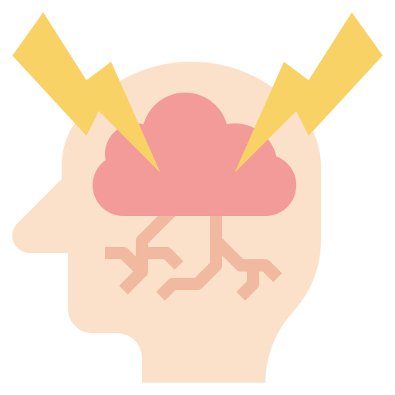

Practical Motivation
Stroke Prediction Dataset from Kaggle was used.
Purpose:
To accurately predict stroke based on common variables shared
Importance in today’s context:
Stroke is the 4th leading cause of death in Singapore (WSO)
Variables are familiar and easy to manage

Slide 5
03
Data Preparation

Slide 6
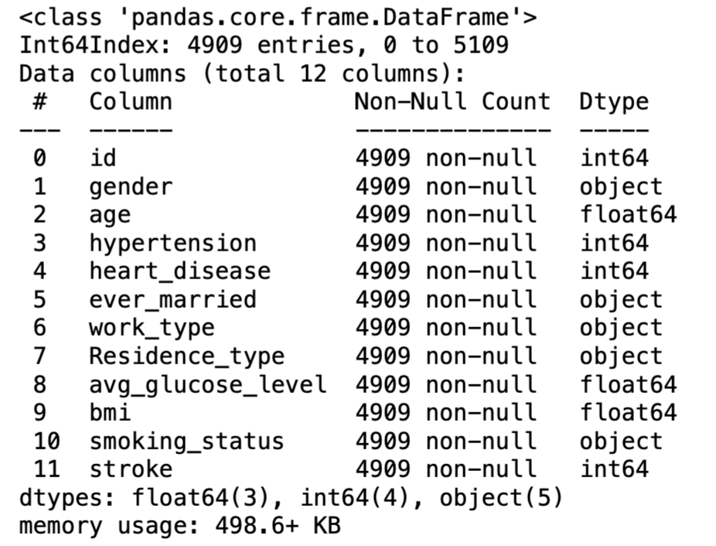
Data Preparation
Remove entries specified as ‘N/A’

Slide 7
03
Exploratory Data Analysis

Slide 8
Variables in Dataset
Response Variable: Stroke
Categorical Variables
gender
hypertension
heart_disease
ever_married
work_type
smoking_status
residence_type
Numerical Variables
age
bmi
avg_glucose_level

Slide 9
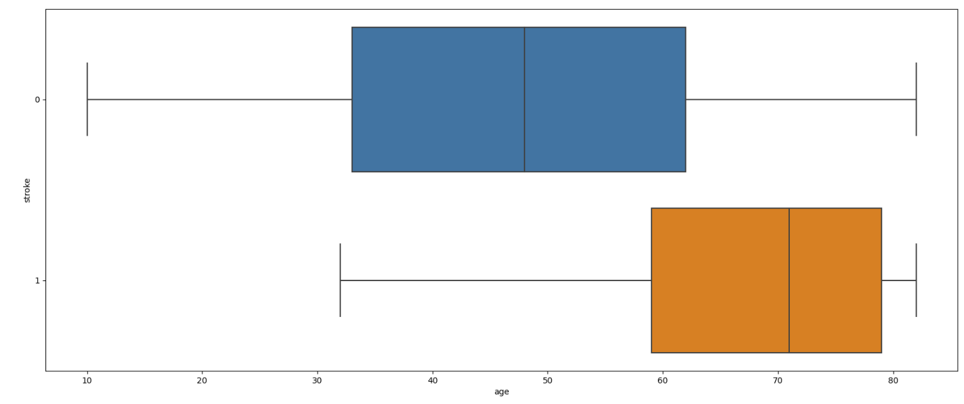
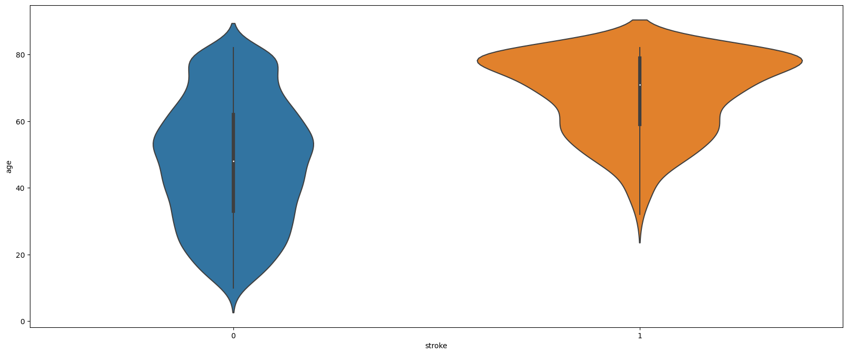
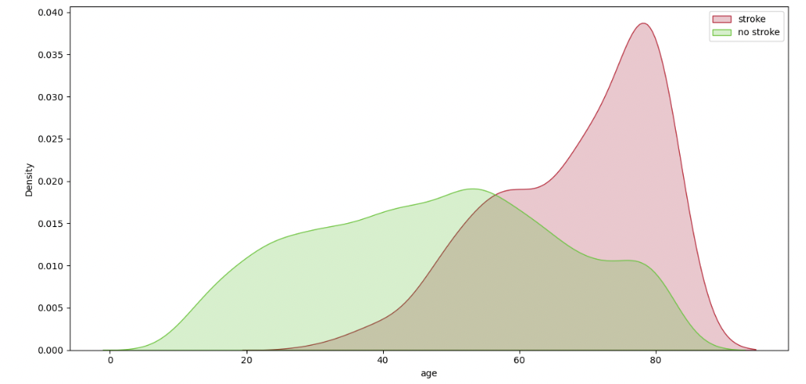
Numerical Variables - Age
Observations:
Minimum age for stroke patients > 30
Older people tend to suffer from stroke

Slide 10
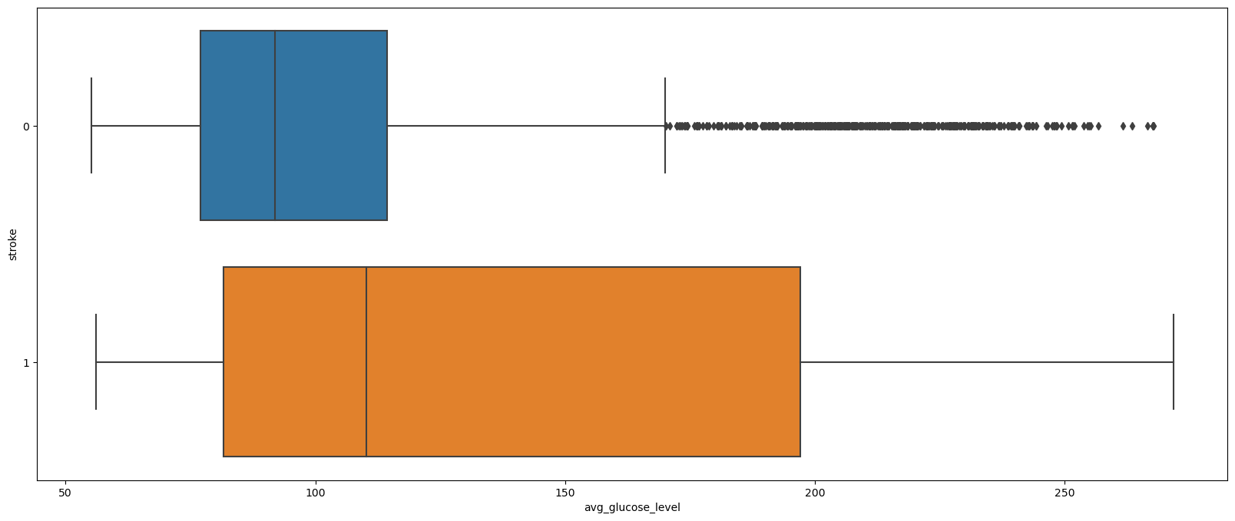
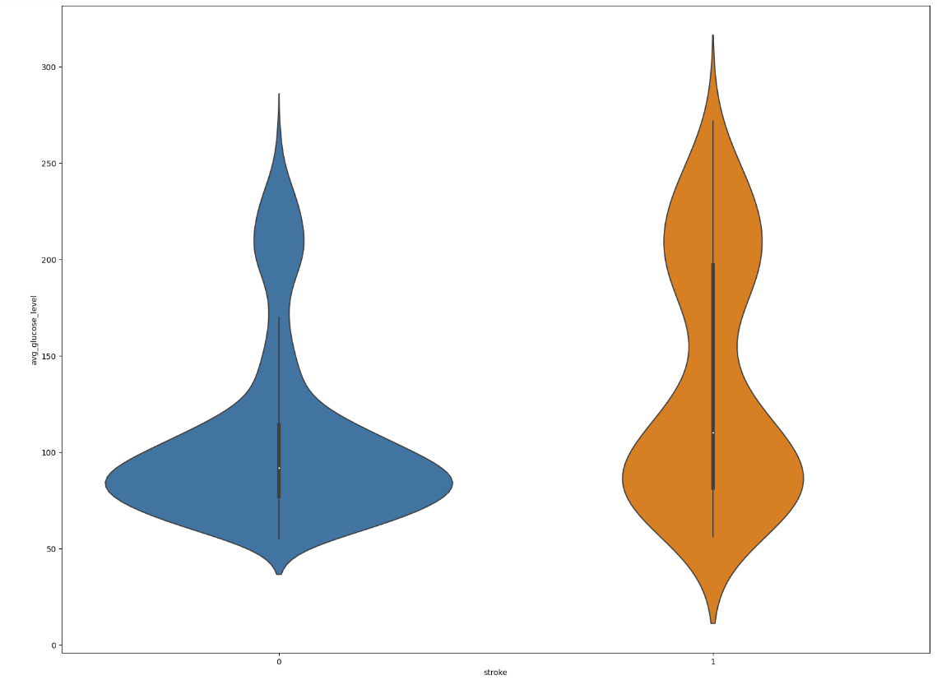
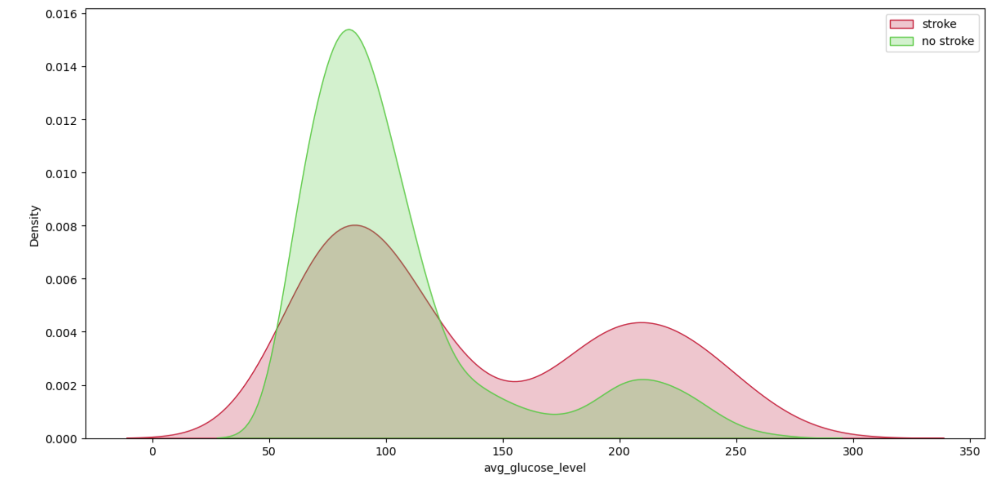
Numerical Variables - Average Glucose Level
Observations:
Large number of anomalies
More even distribution for patients with stroke
Patients with acceptable glucose levels are at less risk of stroke (72 - 99 mg/DL)

Slide 11
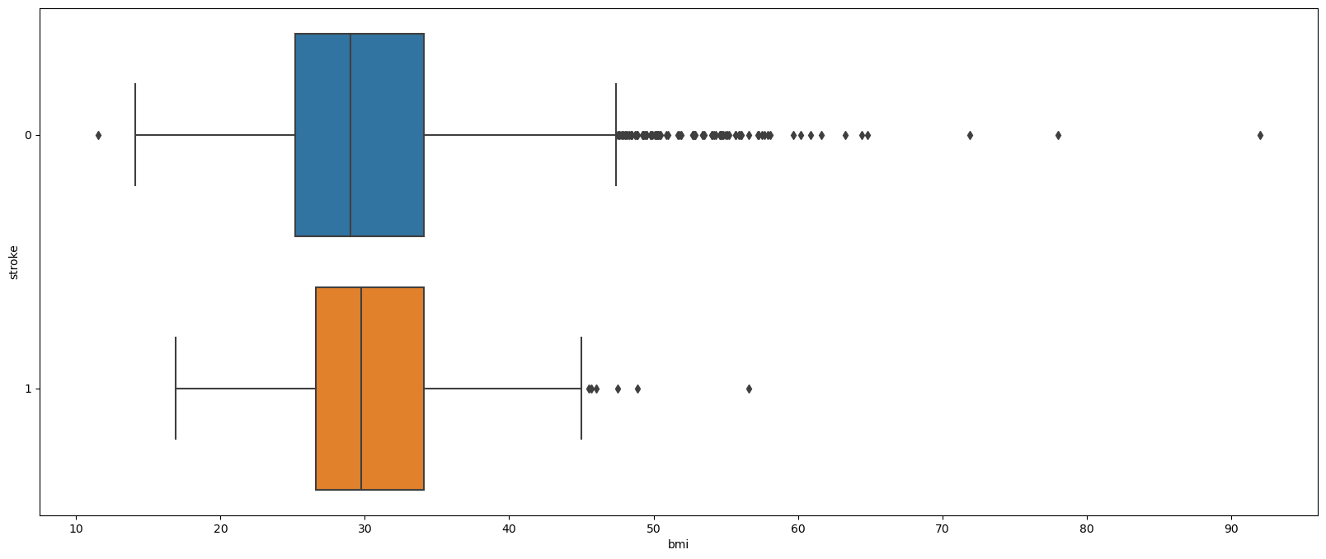
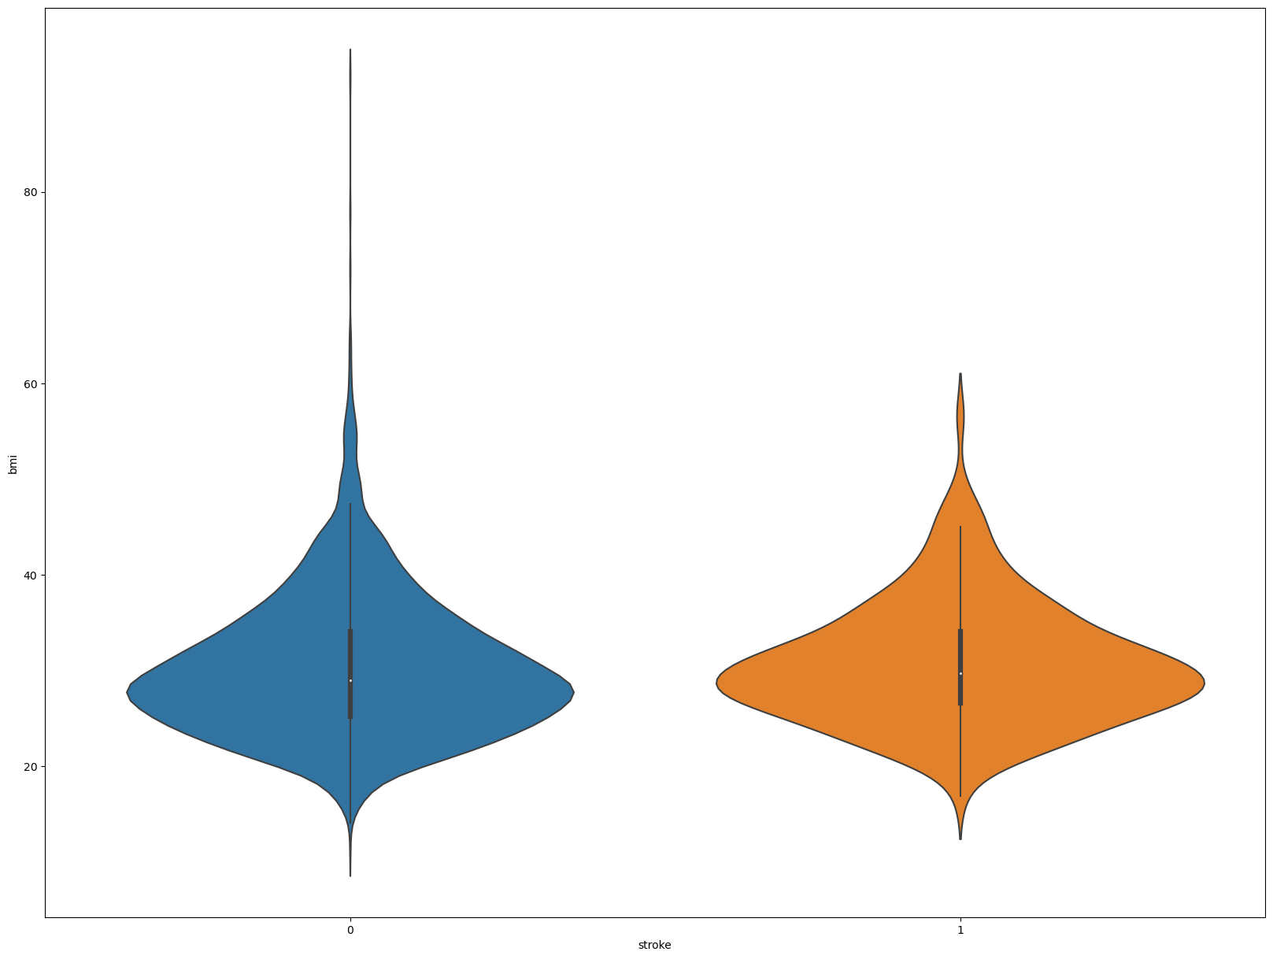
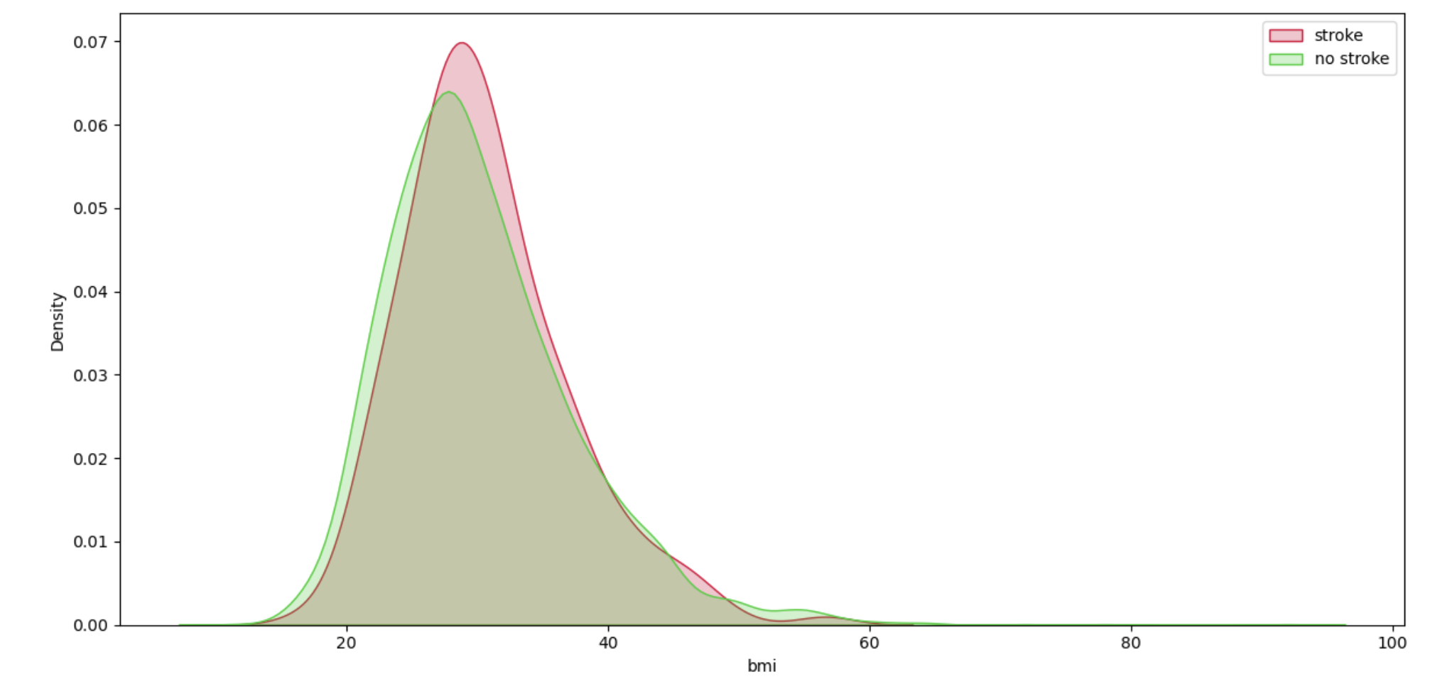
Numerical Variables - Body Mass Index
Observations:
Large number of anomalies
Similar violin plot shapes → Similar distribution of data
Overlap in KDE plot

Slide 12
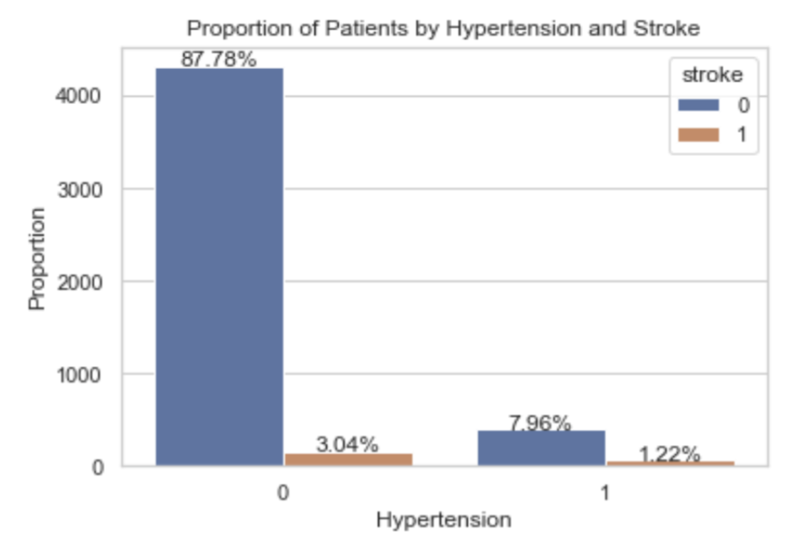
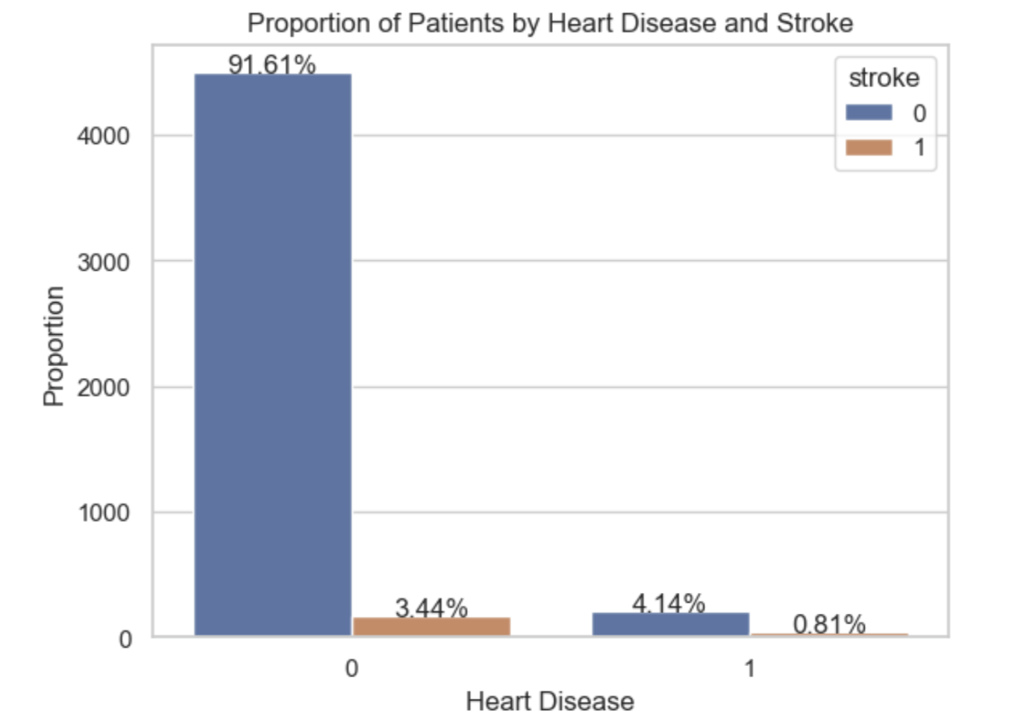
Categorical Variables - Health
Observations:
Higher proportions of patients with hypertension and heart disease have stroke
Can deduce that having health related issues increase chance of stroke

Slide 13
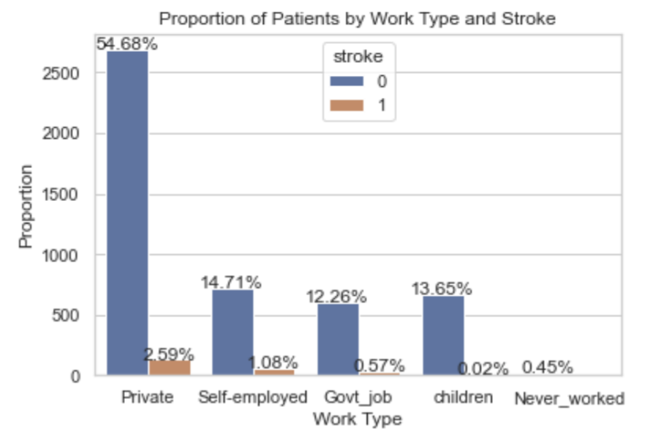
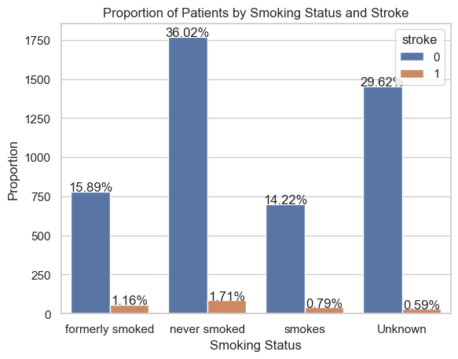
Categorical Variables - Lifestyle
Observations:
Patients who are working (Private jobs, self-employed or government jobs) are more likely to be at risk of stroke compared to children and those who never worked
Patients who smoke (formerly and currently) have a higher risk of suffering from a stroke

Slide 14
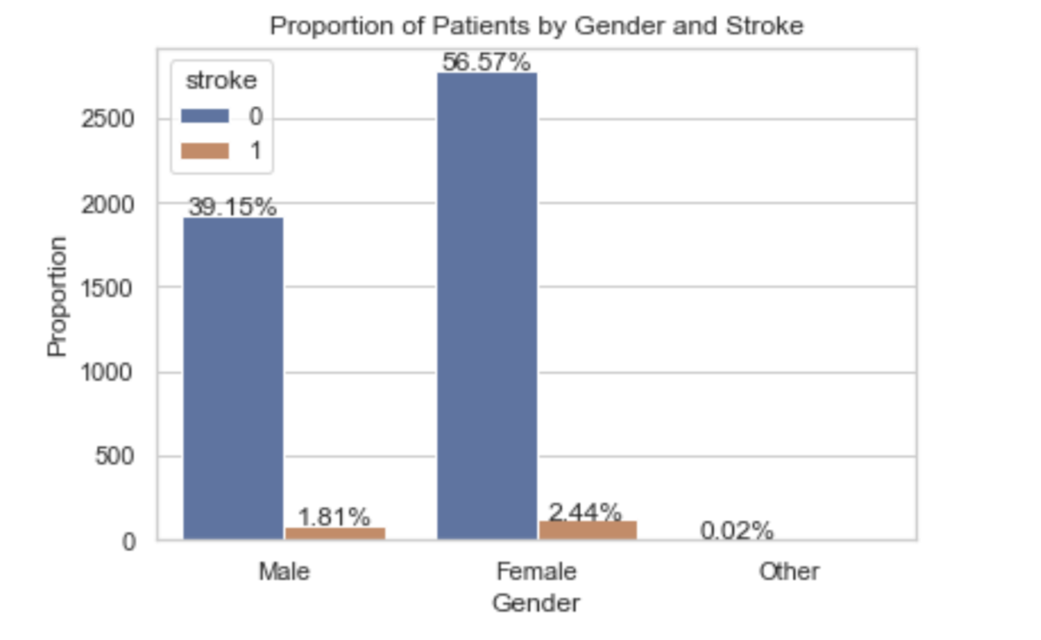
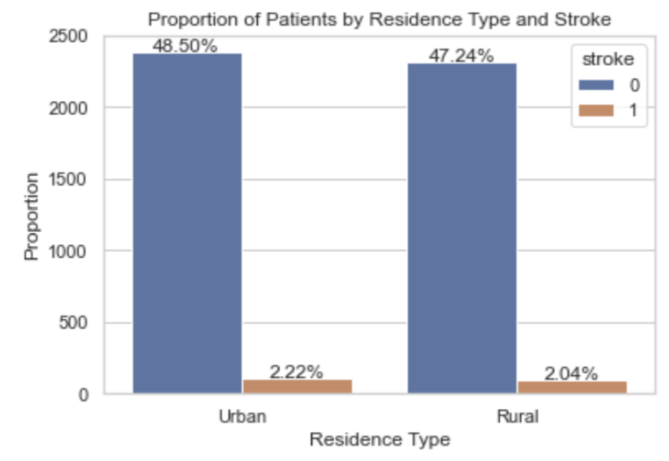
Categorical Variables - Others
Observations:
Although there are more female patients than male, proportion of patients with stroke remain similar in both genders
This is similar for residence type → is not an significant factor in stroke prediction

Slide 15





Relationship between Variables
Positive Correlation between age and heart disease
Patients who were ever married have higher BMI
Positive Correlation between age and hypertension
Self employed individuals tend to be older than those of other categories
Patients who smoke tend to be from urban areas

Slide 16
04
Machine Learning

Slide 17
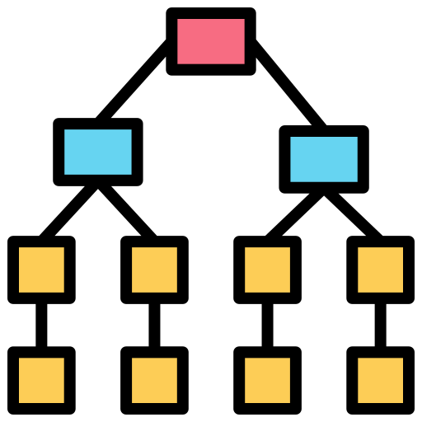
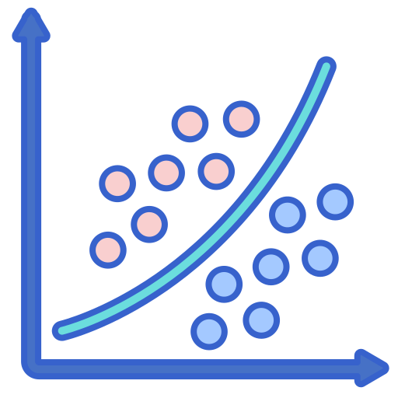

Machine Learning Models
Random Forest
Logistics Regression
Artificial Neural Network (ANN)

Slide 18
Metrics for Model Evaluation
F1 Score
Classification Accuracy

Slide 19



Random Forest Model
Class balancing
Encodes categorical variables via OHE (One-Hot-Encoding)
Fine tuning of number of trees and depth

Slide 20
Random Forest Model
Number of trees: 900
Maximum depth: 10
Classification Accuracy: 0.95
F1 Score: 0.953

Slide 21
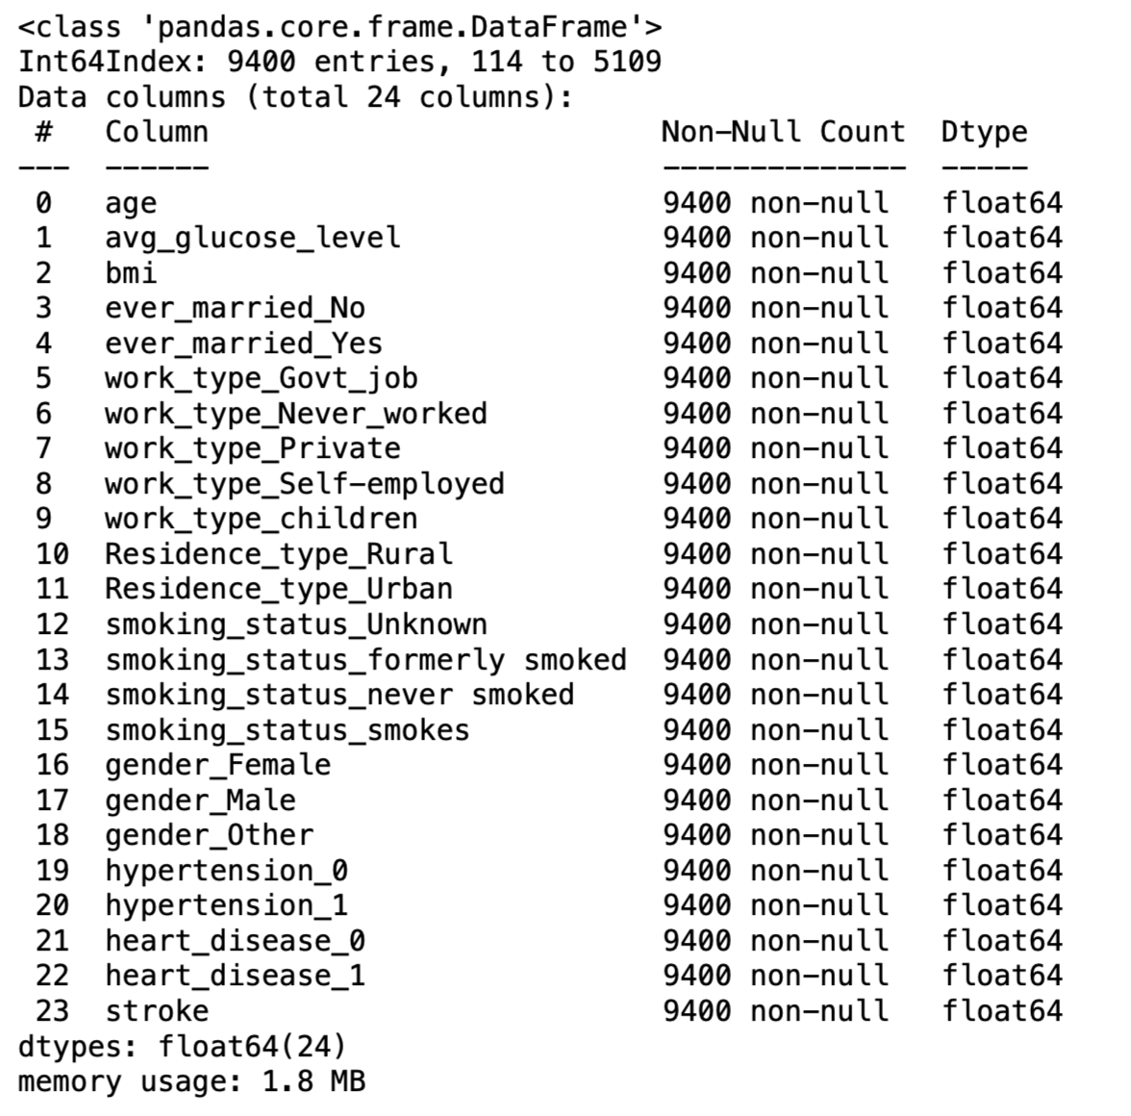
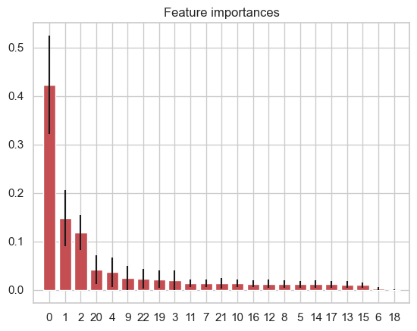
Insight - Random Forest

Slide 22
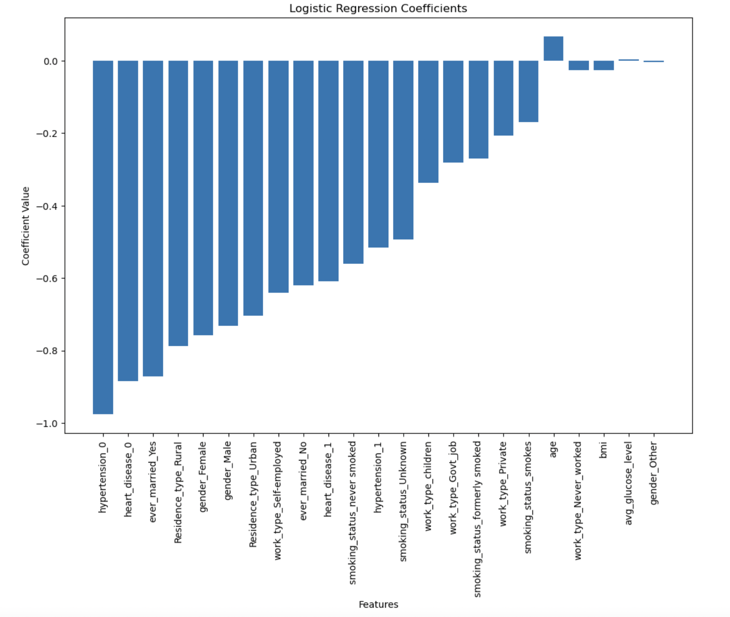
Logistic Regression

Slide 23
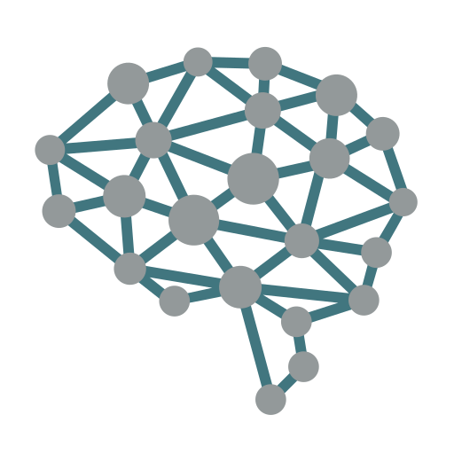


Artificial Neural Network (ANN)
Architecture
Hyperparameters
Learning Algorithms

Slide 24
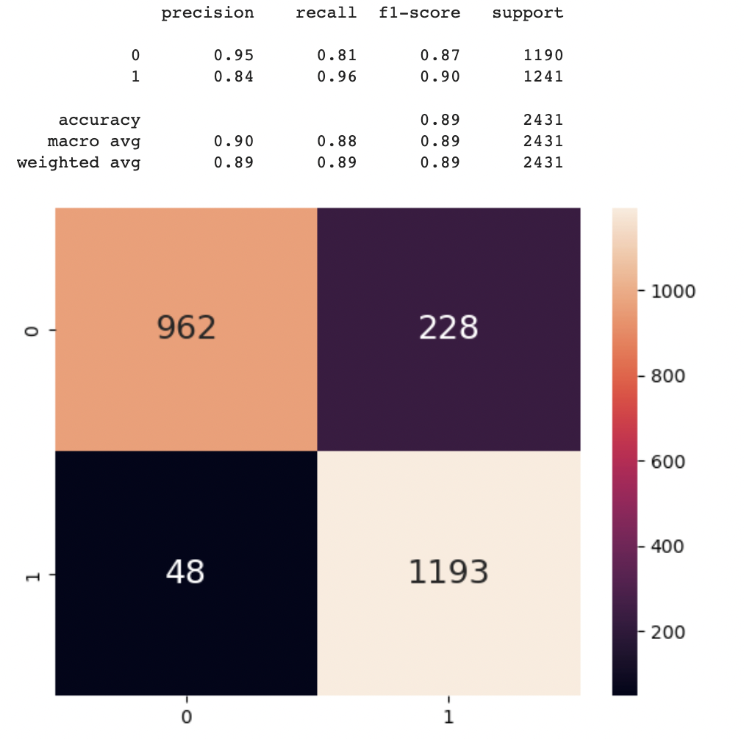
Artificial Neural Network (ANN)
Observations:
Relatively high accuracy and F1 score
Able to be refined further by increasing layer sizes and iterations at the cost of time and computational cost
One drawback → Finding the right parameters has to be done iteratively

Slide 25
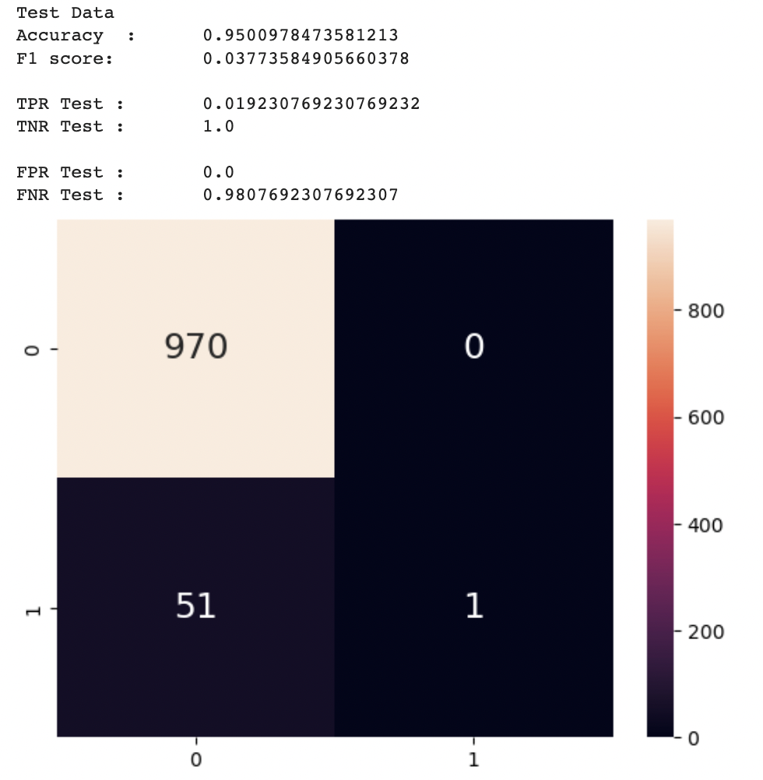
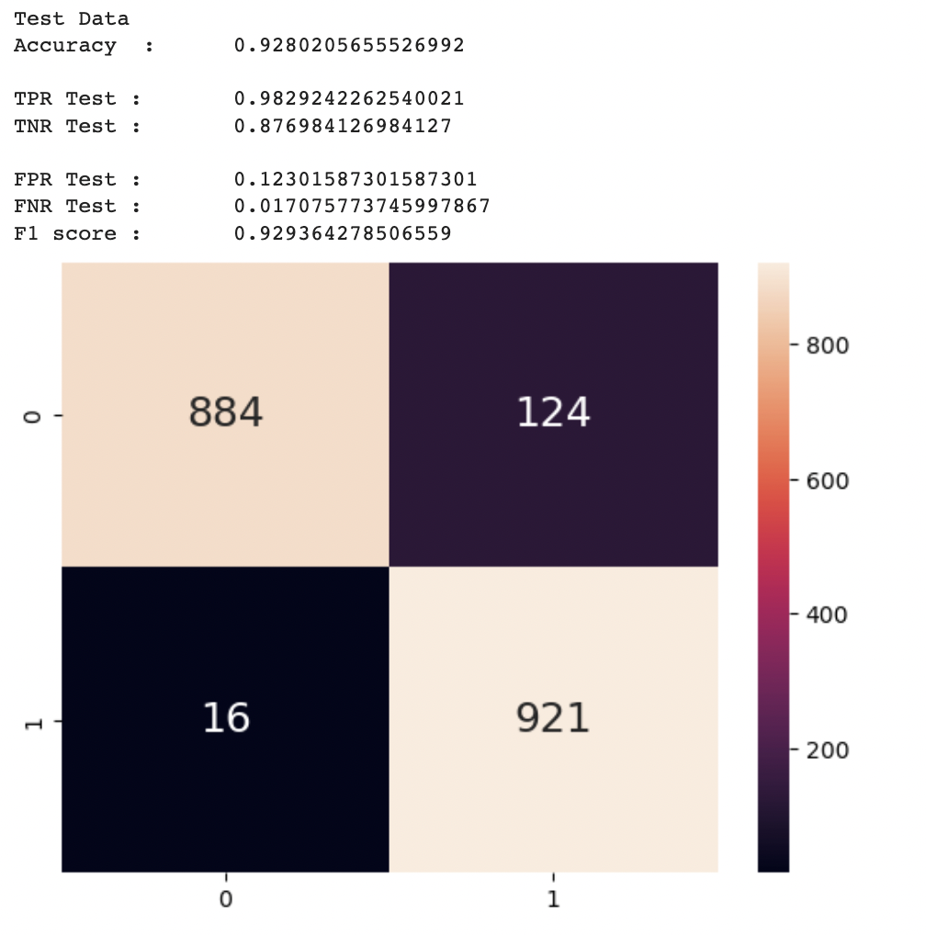
Models Evaluation
Logistic Regression
Random Forest
Artificial Neural Network
High Accuracy and F1 score, with the lowest FNR which is crucial in our problem statement.

Slide 26
Findings & Thoughts
With the high accuracy and f1 scores coupled with low FNR, we achieved our goal of predicting stroke
Several unconventional data that can be used by the health industry for better prediction of stroke such as marriage status, work type & residence type.
Our dataset does not include some variables that can be of significance when predicting stroke such as family stroke history, hours exercise per week etc.
Moving on, instead of predicting whether a person might get stroke or not, we could try to determine the probability of a person getting stroke…

Slide 27
Thank you!

Slide 28
Resources
Vectors
Programming
Development
Mission impossible
Social networking
Segmentation
Site stats
Responsive
Meeting
Analysis
Cyber attack
Secure server
Control panel
Photos
Close-up of woman using a laptop
Beautiful young woman holding laptop on pink backdrop
Icons
Project Management Icon
Find more illustrations like these on Stories by Freepik

Slide 29
Instructions for use
In order to use this template, you must credit Slidesgo by keeping the Thanks slide.
You are allowed to:
- Modify this template.
- Use it for both personal and commercial projects.
You are not allowed to:
- Sublicense, sell or rent any of Slidesgo Content (or a modified version of Slidesgo Content).
- Distribute Slidesgo Content unless it has been expressly authorized by Slidesgo.
- Include Slidesgo Content in an online or offline database or file.
- Offer Slidesgo templates (or modified versions of Slidesgo templates) for download.
- Acquire the copyright of Slidesgo Content.
For more information about editing slides, please read our FAQs or visit Slidesgo School:
https://slidesgo.com/faqs and https://slidesgo.com/slidesgo-school

Slide 30
Fonts & colors used
This presentation has been made using the following fonts:
Fjalla One
(https://fonts.google.com/specimen/Fjalla+One)
Barlow Condensed
(https://fonts.google.com/specimen/Barlow+Condensed)
#494949
#477797
#77c6fc
#bbe3fe
#ddf1fe

